Slide 1
Chapter 2 part 3
STAT441

Slide 2
Measures of Variation
Measures of central tendency provide only a partial description of a quantitative data set. The description is incomplete without a measure of variability, or spread of the data. The most commonly used measures of data variation are
the range
the variance
the standard deviation.

Slide 3
Range
The range is equal to the difference between the largest and the smallest measurements in a data set

Slide 4

Variance
The variance of a sample of n measurements, y1, y2, …, yn, is defined to be

Slide 5

Variance
The population variance is defined to be
for a finite population with n measurements.

Slide 6

Standard Deviation
The standard deviation of a sample of n measurements is equal to the square root of the variance:
The population standard deviation is

Slide 7
Computing measures of variation
Find the range, variance and standard deviation for the sample observations: 1, 3, 2, 2, 4.

Slide 8
Range
The range is simply the difference between the largest (4) and smallest (1) measurement, i.e.,

Slide 9

To obtain the variance and standard deviation we must first calculate
Then the sample variance is
and the sample standard deviation is

Slide 10

It is possible that two different data sets could possess the same range but differ greatly in the amount of variation in the data.
The variance has theoretical significance but is difficult to interpret since the units of measurement on the variable y of interest are squared (e.g., feet2, ppm2, etc.).

Slide 11
The units of measurement on the standard deviation, however, are the same as the units on y (e.g., feet, ppm). When combined with the mean of the data set, the standard deviation is easily interpreted.
Two useful rules for interpreting the standard deviation are the Empirical Rule and Chebyshev's Rule.

Slide 12
The Empirical Rule
If a data set has an approximately mound-shaped, symmetric distribution, then the following rules may be used to describe the data set
1. Approximately 68% of the measurements will lie within 1 standard deviation of their mean
2. Approximately 95% of the measurements will lie within 2 standard deviations of their mean
3. Almost all the measurements will lie within 3 standard deviations of their mean

Slide 13
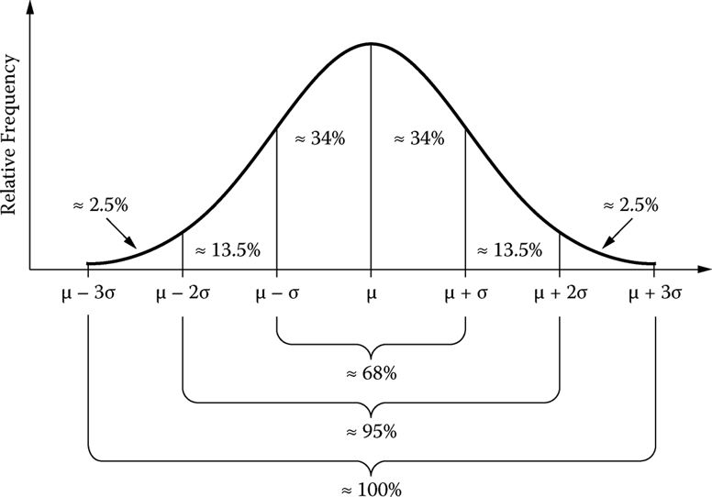
Empirical Rule

Slide 14
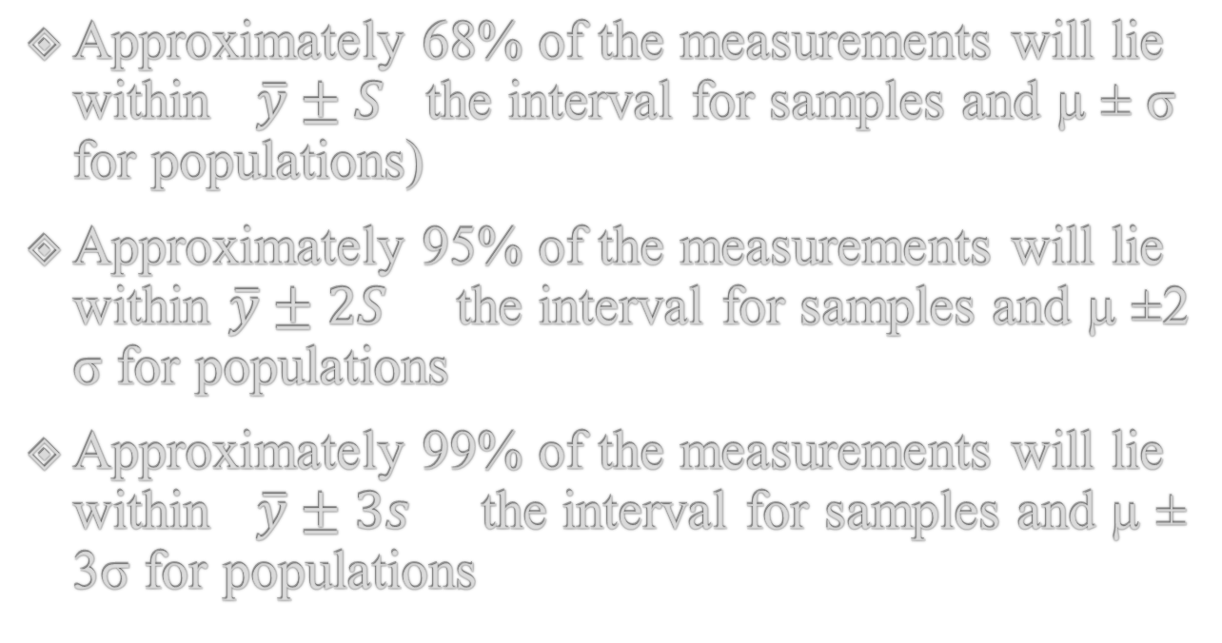
Approximately 68% of the measurements will lie within $\overline{y}±S$ the interval for samples and µ ± σ for populations)
Approximately 95% of the measurements will lie within $\overline{y}±2S$ the interval for samples and µ ±2 σ for populations
Approximately 99% of the measurements will lie within $\overline{y}±3s$ the interval for samples and µ ± 3σ for populations

Slide 15
Chebyshev's Rule
Chebyshev's Rule applies to any data set, regardless of the shape of the frequency distribution of the data
a. It is possible that very few of the measurements will fall within 1 standard deviation of the mean
b. At least of the measurements ¾ will fall within 2 standard deviations of the mean
c. At least 8/9 of the measurements will fall within 3 standard deviations of the mean

Slide 16
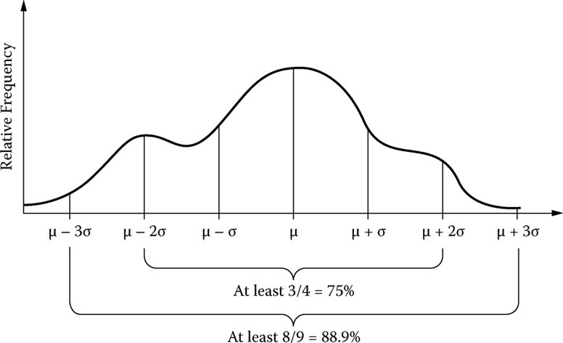

Slide 17
Applying Rules for Describing the Distribution of Iron Ore Contents
For the data on percent iron content of iron-ore specimens. Describe the distribution of iron content measurements.
Estimate the number of the 390 iron-ore specimens that have iron content measurements that fall within 2 standard deviations of the mean.

Slide 18
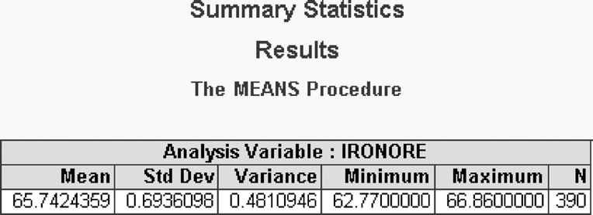
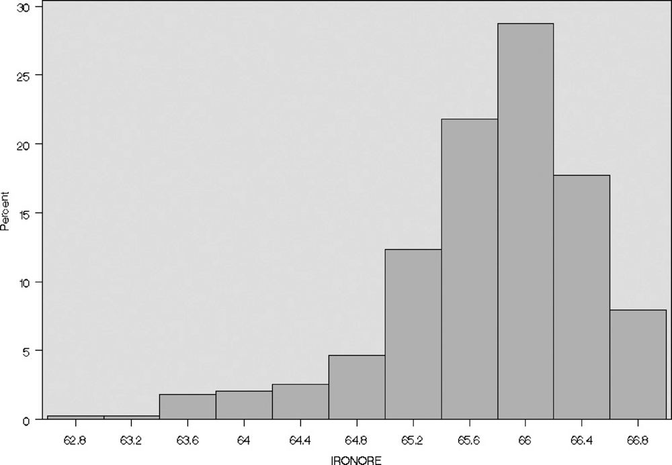

Slide 19
Empirical Rule Chebyshev's Rule
1 (65.05, 66.43) .68 atleast 0
2 (64.36, 67.12) .95 at least .75
3 (63.67, 67.81) .998 at least .889

Slide 20
Empirical Rule
Our best estimate of the percentage of iron content measurements that fall within 2 standard deviations of the mean is obtained using the Empirical Rule—namely, approximately 95%.

